Slide 1
Use Case: Gen-AI-enabled Contextual Chatbot for Real-time Query Resolution
Gen-AI-enabled real-time query resolution for better patient engagement and amplified Clinical Operations
Overview
Business group: CT Clinical Operations | Persona: Principle Investigator, Study Coordinator, Patient, Clinical Research Associate (CRA) |  | Expected Outcome: Contextual chatbot for real-time resolution of protocol-related queries (trial methodology, Inclusion/ Exclusion. Drug regimen, trial visits, data capture, etc) and regulatory (ICH-GCP)-related queries (Informed consent, Protocol Deviations, AE/SAE reporting, etc) throughout the trial
Problem Statement & Solution
Proposed Technology |  | Tangible Benefits
Gen-AI technology | Business Application | Reduce the query resolution time by 60% Improve patient retention by 40% Improve protocol compliance by 40%
Azure Open AI | Python
Key Business Challenges:
Proposed Solution:
Lack of real-time resolution of patient/investigator’s queries leads to:
Protocol non-compliance issues
Poor medication adherence
Lost to Follow-up or dropouts
Delayed trial completion
Regulatory non-compliance / Post submission queries
INPUT
Protocol
ICH-GCP
PRE-PROCESSING
Data collection
Model deployment in Azure OpenAI (AOAI)
Text extraction / Chunk/ Vector store
PROCESSING
(using GenAI Technology)
AOAI API Integration
Train data on AOAI model
Response handling
OUTPUT
Real-time Query Response
Better patient compliance

Slide 2



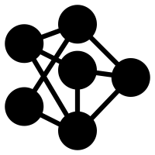
Conventional AI for Chatbots​
Generative AI for Chatbots (Gen AI)
Rule-Based Approach
Conventional AI chatbots operate based on predefined rules and patterns.
They follow a set of predetermined responses based on specific keywords or phrases.
Natural Language Understanding​
Generative AI chatbots, can understand and generate human-like text responses.
They excel in understanding context and user intent, even with diverse and complex queries.
Limited Flexibility
Struggle with handling complex and unpredictable user inputs.
They may fail to understand user intent outside their predefined rules.
Flexibility and Adaptability
Can handle wide range of topics and adapt to different conversational contexts.
They are not limited by rigid rules and can respond to novel queries effectively.​
Complex Interactions
More complex interactions, making them suitable for various applications, from customer support to creative writing assistance.

Slide 3






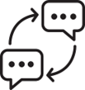

Conceptual Diagram
Backend
Protocol
Data extraction and splitting
Vector store database
User Selects a Study ID
Query from patients, Principal investigator, Patients, study coordinator
User Authorization
Input on website
Frontend
Azure OpenAI
User
Response

Slide 4

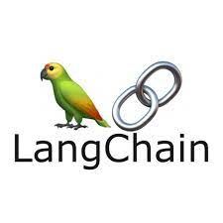


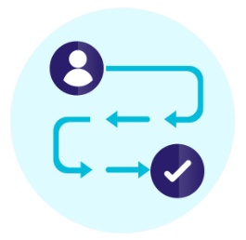

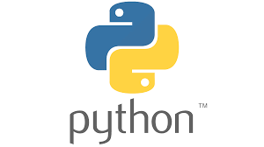

Logical Architecture
Text Extraction from Pdf
Splitting Extracted data into Chunks
Embeddings using OpenAI
Database
PDF File
PDF File
Extracted Text
Smaller Chunks
User select a Study ID
User enters a Query
Embeddings using OpenAI
Vector Database
User-Protocol Mapping
User Interface
(Webapp)
Response
Large Language Model (LLM)
Relevant Chunks
User
User Authorization

Slide 5
Generative AI Interventions
Protocol Understanding: The chatbot can use generative AI to provide detailed explanations of disease protocols, including the rationale behind specific procedures, endpoints, and interventions.
Patient Eligibility Criteria: Generative AI can help the chatbot explain the criteria that determine whether a patient is eligible to participate in a clinical trial based on the disease protocol.
Treatment Procedures: The chatbot can generate responses that outline treatment procedures, dosages, administration methods, and schedules described in the disease protocols.
Safety Monitoring and Adverse Events: Generative AI can assist in explaining how safety is monitored during the clinical trial, including the reporting and management of adverse events.
Trial Phases and Duration: The chatbot can use generative AI to provide information about the different phases of clinical trials and how they relate to disease protocols.
Compliance and Regulatory Guidelines: The chatbot can use generative AI to elaborate on how clinical trial operations adhere to compliance and regulatory guidelines set out in the disease protocol.

